Slide 1
Indiana Career Collaborative
Leadership Day
Ford NGL 101
January 18, 2023
Notes:
1

Slide 2
Ford NGL mobilizes educators, employers, and community leaders to prepare a generation of diverse young people who will graduate from high school ready for college, careers, and life—prepared to apply their passion and skills to improve and contribute to their communities and to succeed in the 21st century economy.

Slide 5
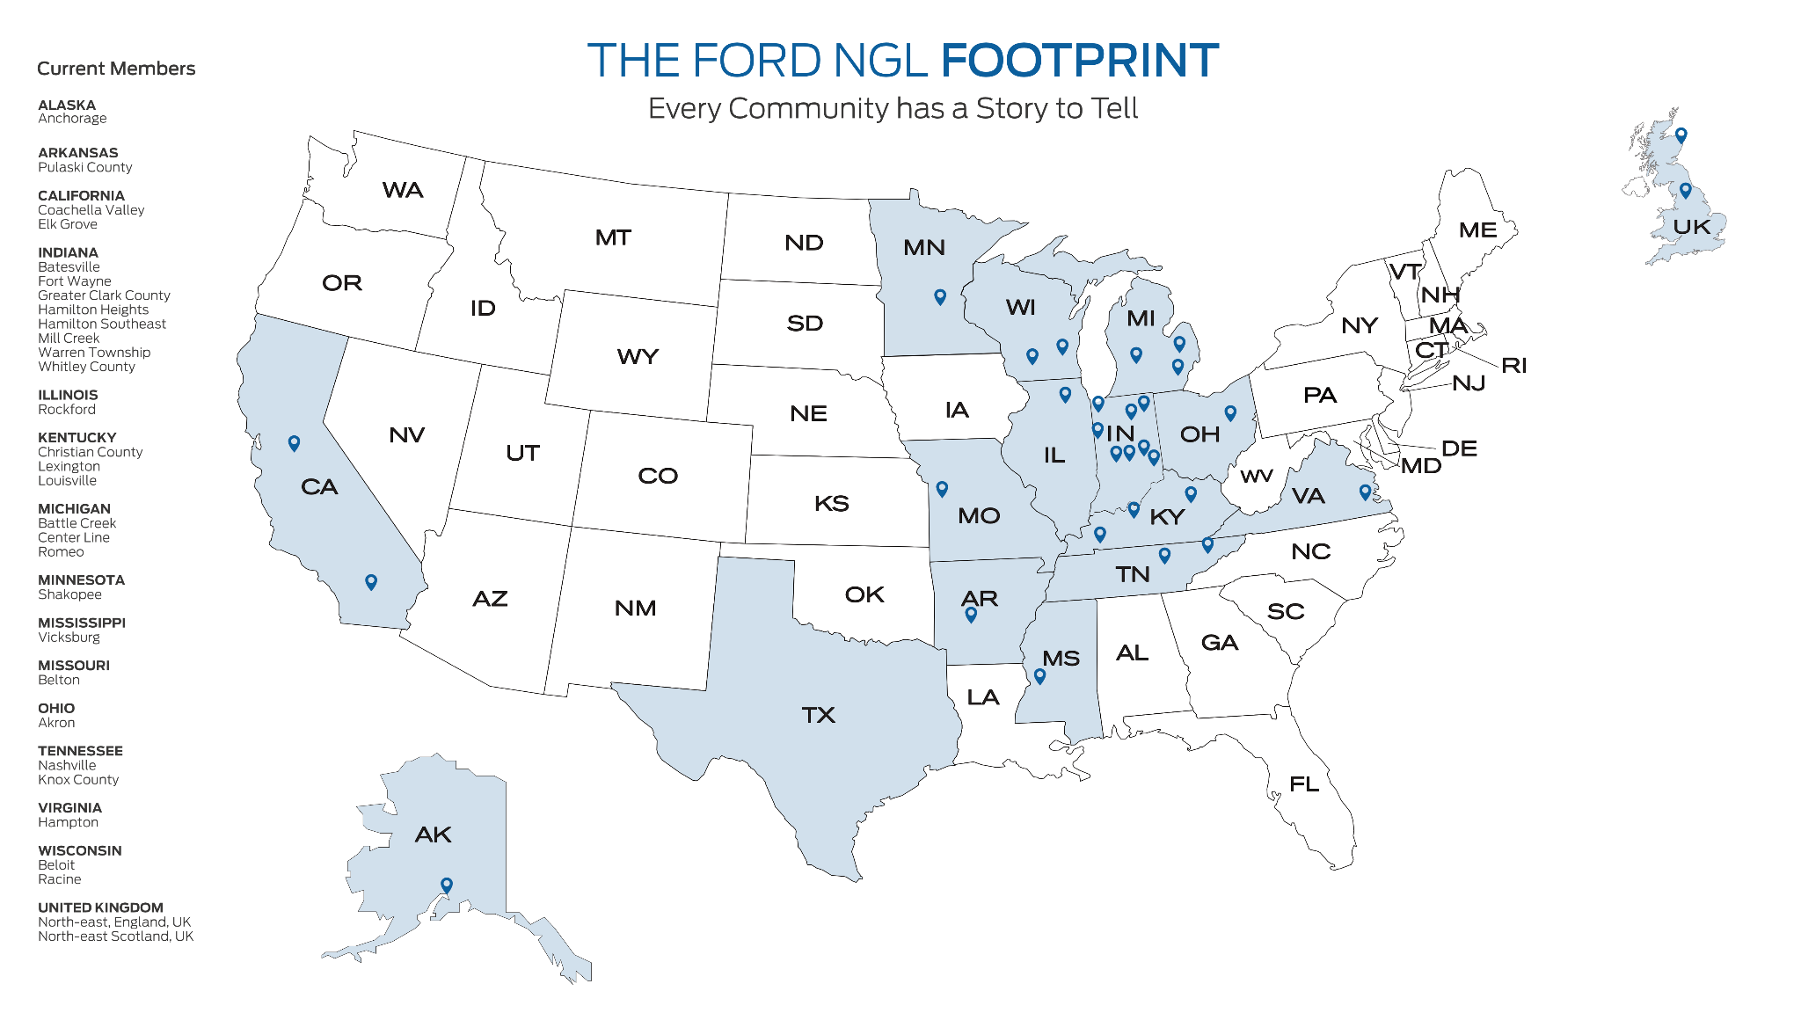

Slide 6
Principles
These principles guide our work with communities in achieving the outcomes.
Equity | All students, including those furthest from opportunity, must have access to and support in pursuing learning and work opportunities.
Student Voice | All students must have choice, ownership, and agency in pursuing their learning and career aspirations.
Community-Connected Approach | All stakeholders in the community (schools, families, business, post-secondary, and community organizations) share responsibility and accountability for designing, implementing, and sustaining the transformation, including the way they communicate, collaborate, and coordinate around their work.
Passion | All stakeholders will demonstrate a relentless quest for excellence - a blend of mind and heart - in pursuing our goals.
Innovation | All stakeholders will continually innovate with new forms and ways of preparing young people for success and fulfillment.

Slide 8
3 MAIN OUTCOMES
IMPROVE
STUDENT
OUTCOMES
IMPROVE
WORKFORCE
OUTCOMES
IMPROVE
COMMUNITY
PROSPERITY
SOCIAL MOBILITY

Slide 9
The Ford NGL Roadmap

Slide 10
PHASE 1: EXPLORE
Duration: 3-5 Months
Understand the benefits and features of transforming the secondary school experience using the Ford NGL community-driven approach.
Readiness and commitment to embrace the Ford NGL transformation.

Slide 11
PHASE 2: ENVISION
Duration: 5 Months
Deepen community-wide understanding of the benefits and features of transforming the secondary school experience using a community-driven approach.
Understand and develop the systems, structures, processes, and leadership needed to implement the plan and guide continuous improvement.
Deepen community-wide commitment to embrace the Ford NGL Model for transformation.
THE FORD NGL ROADMAP

Slide 12
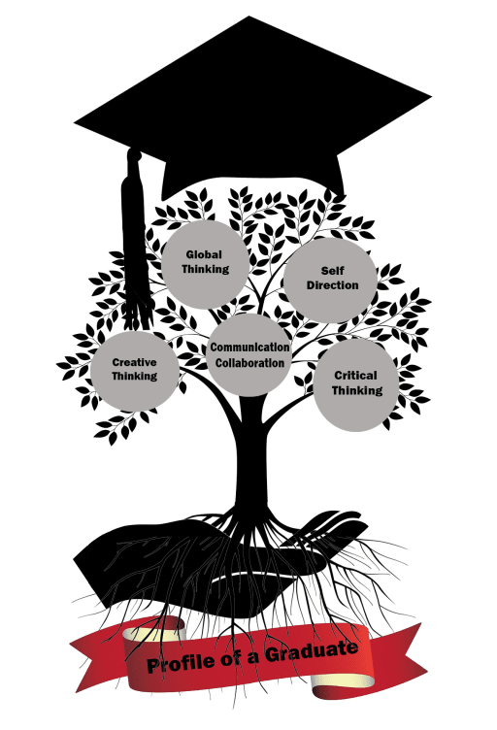
Learner and Graduate Profiles
A graduate profile is what the community wants and expects
Student expectations are what students want from their high school experience
What skills should they have?
How should they think?
What experiences should they have?
What type of person should they be?

Slide 13
PHASE 3: PLAN
7 Months
Achieve community-wide consensus on, and ownership of, a vision for transformation and learn what it will take to implement the vision.
Create a community-wide three-year master plan for achieving the vision that is aligned with the school district’s plans.
Agree on a set of priorities for the first year of implementation.
Strengthen the systems, structures, processes, and competencies needed to implement the plan and guide continuous improvement.
THE FORD NGL ROADMAP

Slide 14
Master Planning Process
What is the Master Plan
The journey to full implementation of transforming districts for college and career readiness.
A guiding document that provides tasks, strategies, action steps, responsible person/persons, and resources.
The community-connected approach to achieving a high fidelity transformation.

Slide 15
PHASE 4: IMPLEMENT
24 Months
Strengthen community-wide capacity to implement and continuously improve the educational system.
Implement the systems, structures, processes, and competencies to support and sustain continuous improvement with all key individuals and groups engaged.
Inspire, share, and contribute to the Ford NGL Network.

Slide 16
PHASE 5: GO FURTHER
Annual
Deepen the implementation of the systems, structures, processes, and competencies to support and sustain continuous improvement including an intentional focus on distributed leadership and succession planning.
Create and share innovations that will support the entire Ford NGL Network.
THE FORD NGL ROADMAP

Slide 17
Ford NGL is a transformational education and workforce initiative of
Ford Motor Company Fund, the philanthropic arm of Ford.
To learn more about Ford NGL visit www.fordngl.com

