Slide 1

Indiana Career Collaborative Leadership Day
Academies 101
January 18, 2023

Slide 2

Academies 101
Notes:
Welcome participants.
2

Slide 3
Outcomes for this Session
Develop a deeper understanding of career academies
Build excitement to start building a dream together!
Answer the question: “What does this mean for me?”
Notes:
Review the goals for this Academies 101 session

Slide 4
WHY Change?
This is different for every community
Notes:
The answer to the “Why Change” is different for every community. The most important thing to remember is to collaborate as a community to come to consensus on that why.

Slide 5

…but this holds true as a desire for ALL
Notes:
While the reason for each community is different, there is one common desire for all—we all want to help build a new generation of young people who will graduate from high school ready for college, careers and life!!

Slide 6

Notes:
At the core of the career academy model, it is about connected learning…..high demand career pathways like IT, manufacturing, healthcare connected to the content students are learning in high school. Also connecting that content to advanced academic course to get a head start in post-secondary.

Slide 7
What are Academies??
Academies offer the small, personalized environment of a small school.
Academies offer applied learning opportunities of themed magnet schools.
Academies partner with businesses to solve real-world problems for authentic learning.
Academies focus on the 21st Century Skills students need to succeed in college and life.
Academies provide a culture of teamwork, critical thinking, communications, collaboration, and creativity.
Academies provide rigorous interdisciplinary curriculum.
Academies prepare students for college and career.
Notes:
So, what are academies? Review the list with an emphasis on small, personalized learning environments that provide students an opportunity to work with business and industry to apply the skills they are learning in high school and to be surrounded by a team of teachers and students that provide support for students to be successful in college, careers and life.

Slide 8
Themed Academies
Elementary School
Relationships
Middle School
Teaming
High School
Rigorous Content
College
Focused Major
Notes:
The academy model includes common elements from all tiers of education:
Elementary school was all about relationships: The model is built on solid relationships across all stakeholders.
Middle schools are great at teaming and academy teaming is the heartbeat of the academy model. This allows that interdisciplinary team of teachers and staff to support the needs of students in a smaller learning environment.
High school is still about building that bridge to post-secondary and the model focuses on continuing the rigorous content of high school but doing it in collaboration with the community.
In college or post-secondary, we have an opportunity to focus or studies on a major or a trade, the academy model allows students to start exploring that focused area early.

Slide 9
Creating a Paradigm Shift
It is not another program. It is doing the work differently.
There is no RIGHT way to do this. But if you don’t start, you’ll never get to where you want to be.
“Slow is Smooth and Smooth is Fast.” – Starr Herrman
This is a journey. The work will never be finished, and it is constantly evolving.
Notes:
The academy model is NOT a program, it truly is transforming the way we do high schools. The beauty of the model is that it is not a cookie-cutter approach, but rather an opportunity to work with a community to design their implementation plan—there is no right way to do it, and we have heard the old saying : “slow is smooth and smooth is fast”….as we go on this journey, we will keep this in mind. True transformational change takes time and very intentional decision-making. This is a journey, and we realize it will be constantly evolving.

Slide 10
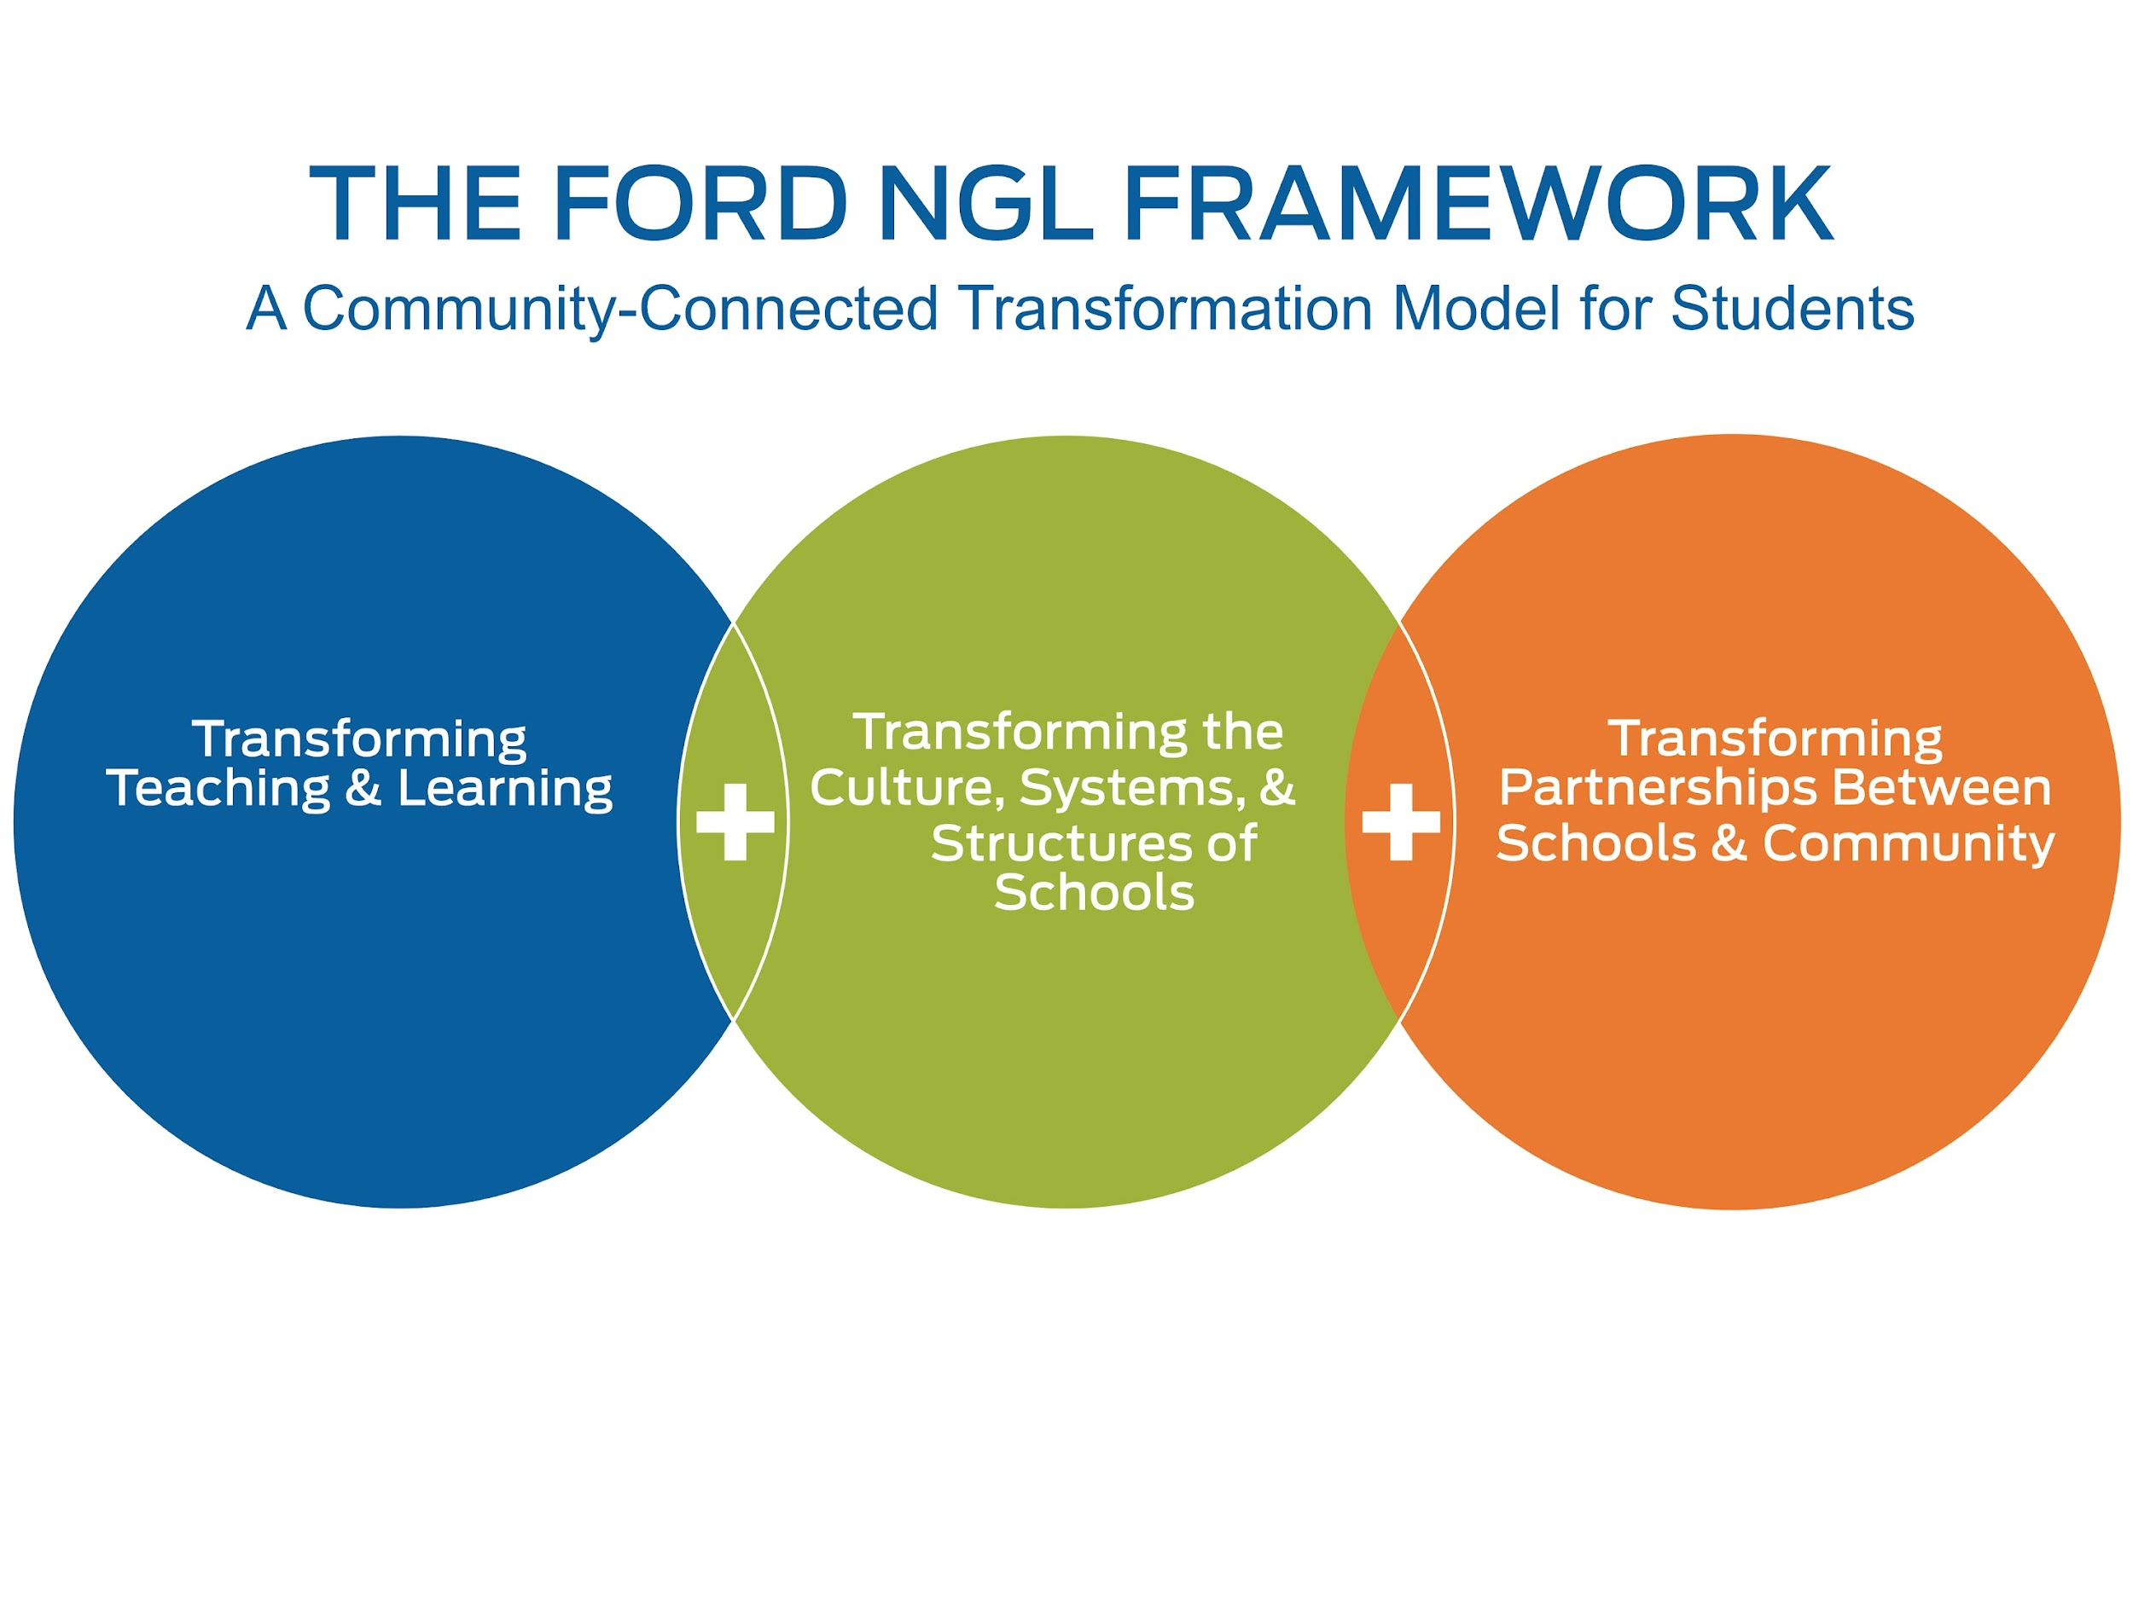

Notes:
We will be using the Ford NGL Framework as we start this journey and keep these three strands of work at the core of all of our work. During the rest of this presentation, we will walk through each strand, but let’s start with the middle as it is all about systems, structures and process of schools.

Slide 11
Notes:
First, let’s look at this graphic to see what a wall-to-wall academy school will look like. As we mentioned earlier, it is all about taking large comprehensive high schools and breaking them down into smaller personalized learning environments. You can see on this example; this school has a Freshman Academy where all 9th graders transition from middle school to high school together and then four additional themed academies. We will get into the themed, but let’s looks at the people. You can see by the red circle; each school will continue to be led by an executive principal and each academy will have an academy principal. This model is excellent for leadership development as the Academy Principal will manage all aspects of their smaller school within a school. Each academy also has a school counselor and a team of teachers to support a cohort of students.
Now let’s go down one level and talk about each academy a little more…..

Slide 12

Academy Teams: Administrator, Counselor, Teachers and Students—ONE Family
One Assistant Principal, One Counselor, Teacher Team Lead, and Admin Assist.
Team of interdisciplinary teachers
Cohort of 400-500 students interested in the same industry theme and scheduled to spend half of their day with the team of teachers
Notes:
As you can see in this graphic, each academy is indeed a smaller learning environment with a leadership team of an academy principal, a counselor, a teacher team lead and an administrative assistant that will help manage the small school or academy. There will be an interdisciplinary team of teachers—English, Math, Science, Social Studies and pathway teachers that will work collaboratively to support students through student interventions and instruction. Each academy will house a cohort of 400-500 students interested int eh same industry theme and schedule to spend half of their day with this team of teachers.

Slide 13
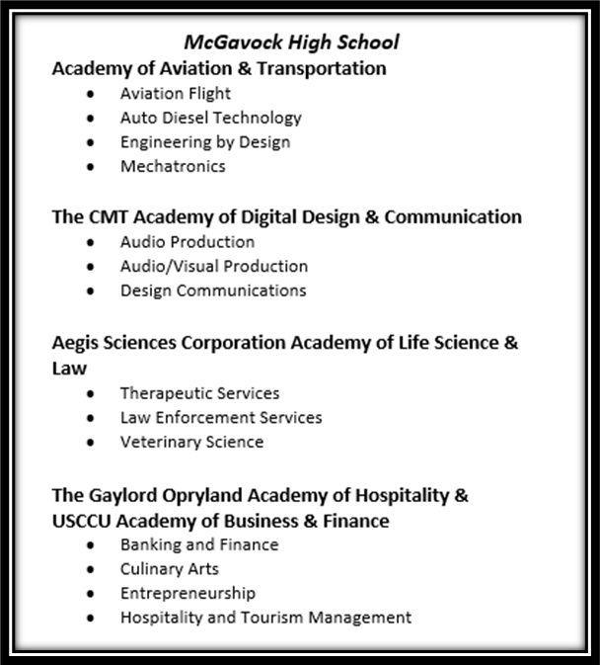
Academy Structure
Themed Academies– determine which pathways can be grouped together by industry themes
Pathways – determine course sequence for students to follow
Notes:
Remember we talked about those themed academies, here is a sample of what this looks like—this school has a themed academy of Aviation & Transportation with pathways of Aviation Flight, Auto Diesel Technology, Engineering by Design and Mechatronics. You can see other examples from this school, but again, each academy has a theme with pathways that fall within that theme.

Slide 14

Determining Academies
Workforce Projections
Current Resources
Possible Community Partners
Student Survey
Pathway Sequence
Notes:
One might ask how a school determines which pathways to offer: first and foremost, we must look at regional workforce data to see what jobs are in demand in our region. As you can see the workforce data is not the only deciding factor as we also want to look at our current resources, input from community partners and include student voice.

Slide 15
Interdisciplinary Academy Team Planning
(Math, English, Science, Social Studies, Pathway)
Weekly Team Meetings During Scheduled Common Planning
Interventions for Student Support
Ensure Relevant, Real-World Connections
Design Interdisciplinary, Standards-based, Project-based Units of Instruction
Create & Maintain Academy Team Identity
Notes:
Remember when we talked about the middle school teaming—the academy team working as an interdisciplinary academy team is truly the “heartbeat” of the academy model. As you just saw in the graphic, this team of teachers will work together to support students. Again, this team will be composed of English, Math, Science, Social Studies and pathway teachers, which is often a CTE teacher. This team of teachers will have common planning time where they can come together once a week to make decisions and build supports for their students. You can see some of the things that will occur during this common planning time on the screen—student interventions, connecting content to the real world, designing interdisciplinary units and building a culture and identity for the academy.
Most importantly, this team of teachers will become the family for our students. They will know that each and every one of them have adults that they can trust to support their growth and learning and while we have always provided that support for most of our students, in this smaller learning community, we will be able to ensure that all students that those five caring adults in their life.

Slide 16
Content/Course Alike Planning
Weekly Team Meetings During Scheduled Common Planning
Pace and Sequence Instruction
Discuss Effective Teaching Strategies
Create Common Summative Assessments
Analyze Assessments (Building Level, District Level, and State Level Testing Data)
Notes:
It is also important to know that content planning is still vitally important, and we will continue to plan with our like content colleagues.

Slide 17
Pathways and Scheduling
Strand 2
Master Scheduling is the foundation to a successful academy.
Course Sequencing
Student voice and choice – not tracking
Purity among academies – both students and teachers
  50% of the student’s day should be spent with their academy
Notes:
As I mentioned earlier, decisions will be strategic and intentional. To accommodate the academy model, master schedule planning will be very important to ensure teachers plan together to support students, course sequencing to make sure foundational skills are developed before moving to a more advanced class and student voice will always be very important.
You will begin to see the work “purity” as we talk about the academy work. This simply means that all students spend at least half of their day with their academy family—that Math, English, Science, Social Studies and pathway teacher that we discussed. The other half of the day, they will spend with what we call “global teachers” or those teachers that support students from all academies such as foreign language, art, music, wellness, etc.

Slide 18
Notes:
Now that we have talked about the major structures for the academy model, let’s shift our attention to Transforming Teaching and Learning, or what goes on in the classroom.

Slide 19
Transforming Teaching and Learning
Project and Inquiry-based through real-world application
Work-based learning experiences for all students
Advanced Academics options – AP, IB, Cambridge AICE, and dual enrollment
Virtual/online learning
Professional Development: Teaching on the Block, Interdisciplinary Teaming for Academies, PBL, Working with Business Partners, and Teacher Externships
Notes:
Much of the instruction that goes on in our classrooms will continue—but with a shift to student centered learning with students being curious. All students will be able to explore careers within the academy theme and learn how to apply what they are learning through projects and real-world application. Advanced academics, such as AP, IB, Cambridge, Dual Enrollment will continue and will have an even greater focus as academies are implemented.
For any change that we ask you to make, we will support each of you will professional development—you can see a few examples of trainings that we will offer to our educators.

Slide 20
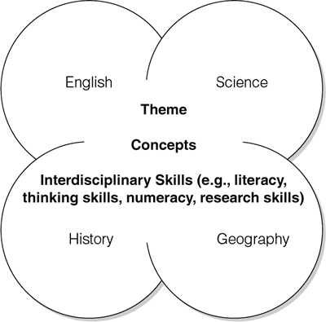

Teaching through the lens of the academy
Inquiry
Creativity
Problem
Solving
Academy Theme
Collaboration
Engagement
Notes:
One phrase that you will often hear is “teaching through the lens of the academy”. First, please know that core content teachers will continue to teach their standards—we are not asking you to change what you teacher. Teaching through the lens often provides context to the students for their full understanding and for a teacher, that might mean that you start your class with an example of how the content is applied in the industry. In education, we call that the “hook”. So if you are a Geometry teacher teaching in a Construction academy and about to start a unit on angles, you might connect it to the pitch of a roof before jumping into the academic standards. This provides students a context and sets them up for understanding. Those critical employability skills of collaboration, communication, and problem solving will be taught across all subjects.

Slide 21
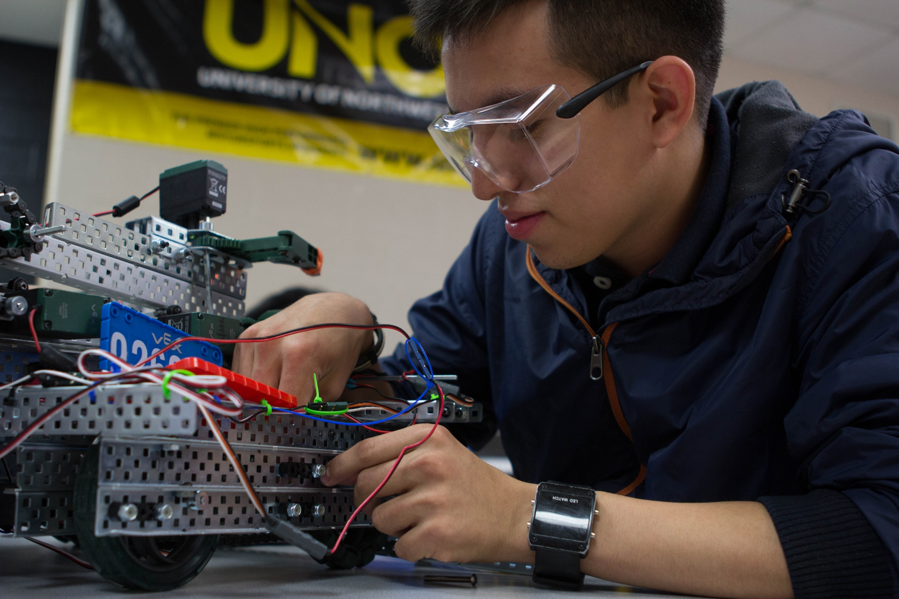


Experiential Learning Model
Capstone or Apprenticeships
Job Shadowing
Industry-related Fieldtrips and Guest Speakers
Career Fair and College Visits
12th Grade
11th Grade
10th Grade
9th Grade
Notes:
As I mentioned earlier, all students will be able to explore careers within the academy theme—while the Knox County model is not confirmed yet, this is an example of an experiential learning model where all 9th graders attend a Career Fair and a College Visit in their Freshman Year; in their 10th grade year, students attend an industry-related field trip and have guest speakers in their classrooms; in their 11th grade year, students have learned more about the industry and go on a job shadowing experience; in their senior year, all students complete a senior capstone course or engage in an apprenticeship.
This is truly community connected learning and provides students an opportunity to explore what they might want to “do when they grow up”.

Slide 22
Teacher Experiential Learning
Advisory Boards
All academy teachers are part of the academy advisory board and meet with partners quarterly to plan academy work.
Industry Experiences
Academy team visits to a business partner to learn more about the work of the partner and how to align the industry to content standards.
Reverse Job Shadows
Business partners shadow general education teachers to help teachers and students better understand how English, Math, Science, Social Studies, etc. are used in industry
Externships
Teams of teachers spend multiple days with a business partner to design an interdisciplinary PBL unit.
Notes:
We also believe that teachers need this same level of exposure to academy-related experiences to better prepare students. Here are just a few ways that teachers learn from business and community partners. As the relationships grow, teachers learn more about the industry theme of their academy and become better equipped to “teach through the lens” of the academy.
Review each section.

Slide 23
Teacher Externships
Teachers learn how their content is applied in workplace
Academy teams of 3-5 teachers
Core content and pathway teacher
2-3 days in business
Develop an interdisciplinary unit
Notes:
I want to take a moment to highlight teacher externships as they truly are some of the best teacher professional development. We have all been in the classroom when the student raises their hand to ask “when will I ever need to know this”. The teacher externship equips teachers with the answer to that age-old question and helps build relationships between teachers and the business partners that will influence countless classroom discussion. The externship usually occurs during the summer where a small team of teachers visit a business to learn more about the industry and to build an interdisciplinary unit for their students. Regardless of industry or experience of the teachers, the visit always starts with how do you use English, Math, Science, etc. in your organization.

Slide 24
Notes:
Finally, the third strand is all about transforming partnerships between schools and the community. This is where you will most likely see the biggest shift and will help us transform our schools.

Slide 25
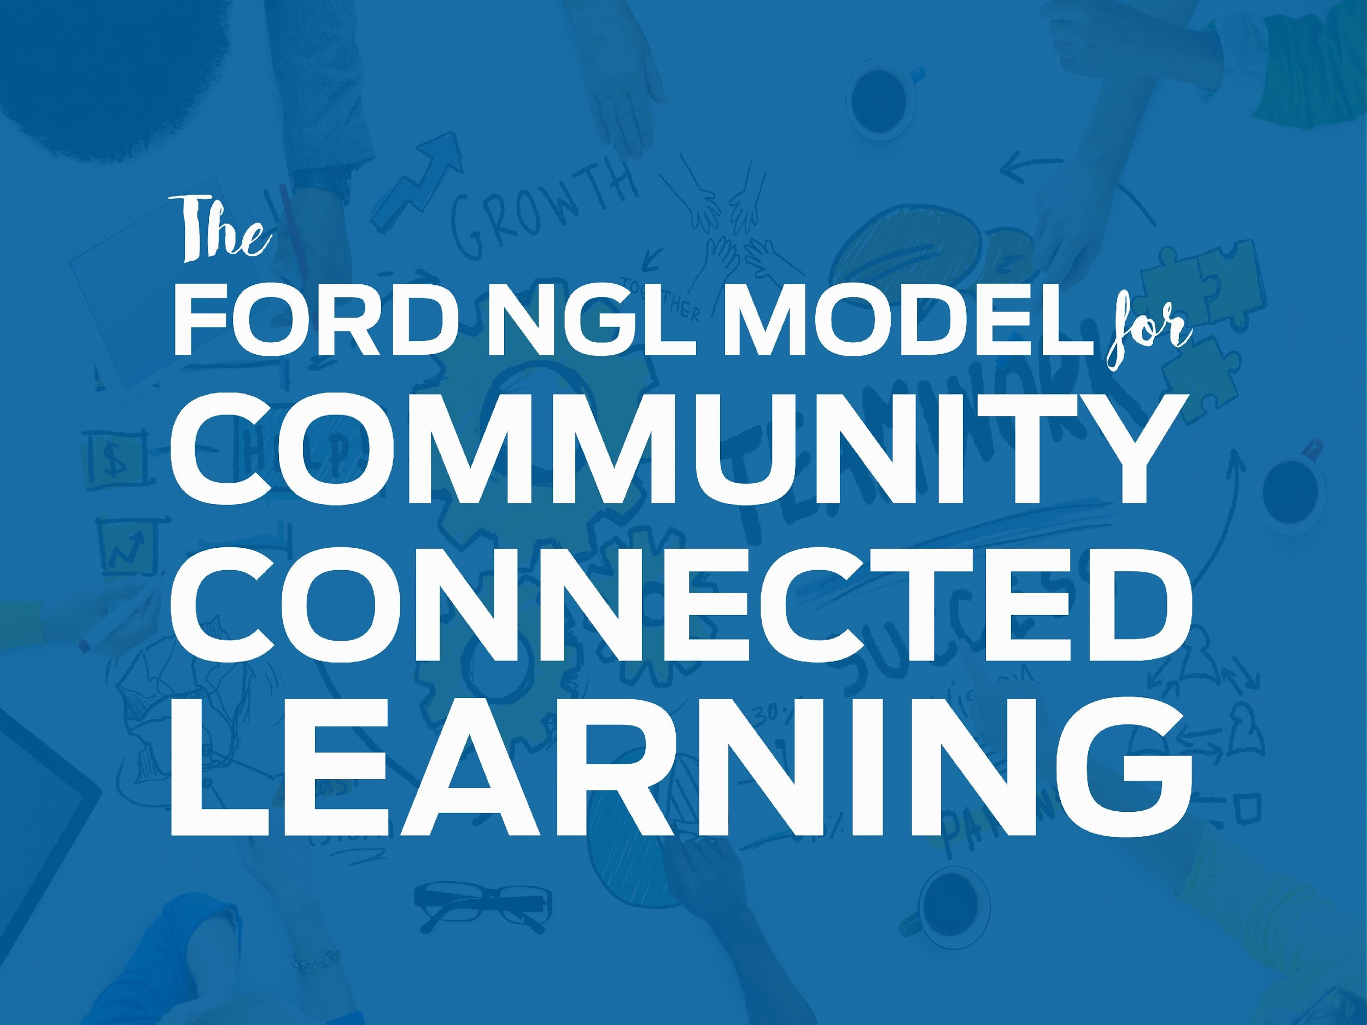
Notes:
As you have heard, this model is truly a community connected learning model—so what does this look like. First, I can tell you what it will not look like—it is not the community coming into your house telling you what to do. The model is about the entire community…..business partners, foundations, educators, students, families, post-secondary partners—all community stakeholders coming together to support all aspects of the work.

Slide 26

Transforming Partnership Between Schools and Community
A game-changer
Room at the table
Business, civic, post-secondary—the community
Notes:
For most educators, these partnerships are truly the game-changer—it is about the entire community coming together to support our students.

Slide 27
Transforming Partnership Between Schools and Community
Sustained through Business and Post-Secondary Partnerships
Partnerships
Experiences
Knox County Community
Strategic partnerships with business, non-profits, and post-secondary
Work-based learning for all students
Real-World Design
Career Exploration
Learning spaces and experiences
Job Shadowing
Student Internships and Capstone
Notes:
This graphic shows a few ways of how the business and community will support our academy work. Walk through each one.

Slide 28

Notes:
What questions do you have?

Slide 29
Academies 101
Notes:
29

